Slide 1
BRFSS: The Behavioral Risk Factor Surveillance System
By: Isabella Zabaleta, Sydney Westfall, Jason Zhang, Anjala Khadka, Sireesha Annam

Slide 2
Why Did We Choose this Dataset?
Every 40 seconds someone in United States has a heart attack (CDC, 2022).
The benefits of physical activity (Myers, 2003)
Recurrent cardiovascular event associated with alcohol consumption (Ding, et. al., 2021)
How cardiovascular/heart disease risks vary by race and ethnicity (Cleveland Clinic, 2022)
The Behavioral Risk Factor Surveillance System (BRFSS) established in 1985 is a national health-related-telephone survey that collects state data about U.S. residents regarding their health-related risk behaviors, chronic health conditions, and use of preventive services in all 50 states as well as the District of Columbia and three U.S. territories. It is the largest continuously conducted survey which collects more than 400,000 adult interviews each year. This survey has been helpful to target and build health promotional activities.
Notes:
Deep dive - Optimal population health - US geographically inclusive
Having a variety of data allows us to strengthen statistics by broadening the scope, makes a graveyard of data meaningful
Steps away from a b analysis and proves not only the difference but the significant difference
Pre and post benefits for Cardiovascular Risk Factors

Slide 3
Dependent variable:
Heart Attack
Categorical variables:
Age
Race
Sex
Hypertension
Cholesterol
Heart Attack
Physical activity
Smoking
Independent variables:
Age
Sex
Race
Hypertension
Cholesterol
Physical activity
BMI
Average alcoholic drinks
Smoking
Vegetable consumption
Continuous variables:
Average alcoholic drinks
Vegetable consumption
BMI

Slide 4
Descriptive Statistics: one continuous variable, one categorical variable, one continuous variable grouped by a categorical variable
Average alcoholic drinks per day in the past 30 days- Continuous (histogram and boxplot)
Physical activity- categorical (pie and bar chart)
BMI- continuous
Smoking - categorical
Notes:
Describing features of a data set and generating summaries

Slide 5
Continuous Variable: Alcohol Consumption
How many drinks does the average person have in 30 days?
set project;
where AVEDRNK3~=77 OR 99; /*77= dont know, 99= refused*/
run;
proc univariate data=alcohol normal plot; /*we want a histogram*/
title 'Descriptive statistics for Alcohol Consumption';
var AVEDRNK3;
Run;
Notes:
1-76 drink
77-don’t know
99-refused

Slide 6
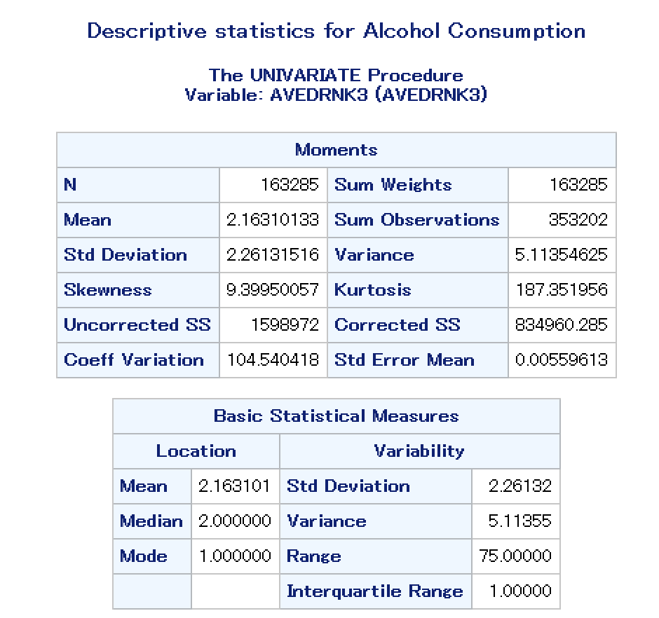
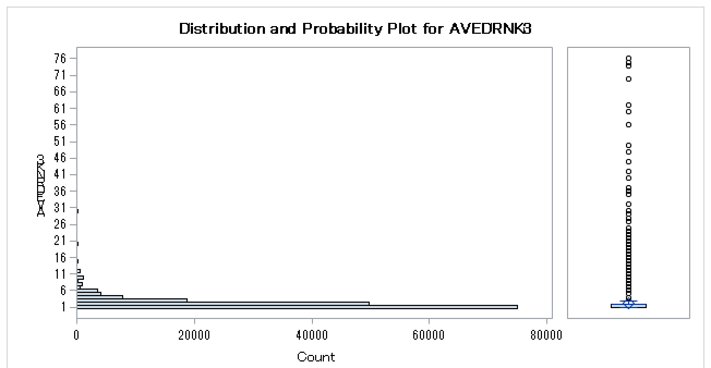
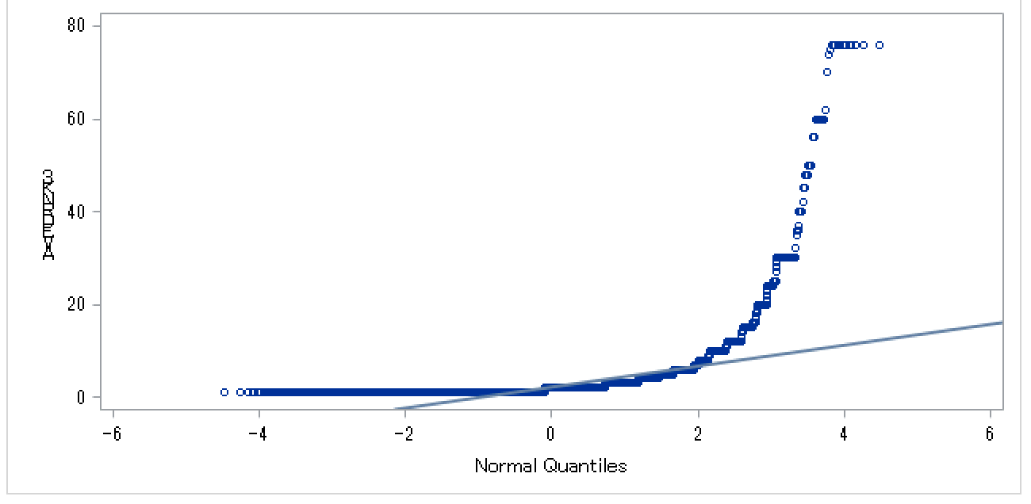
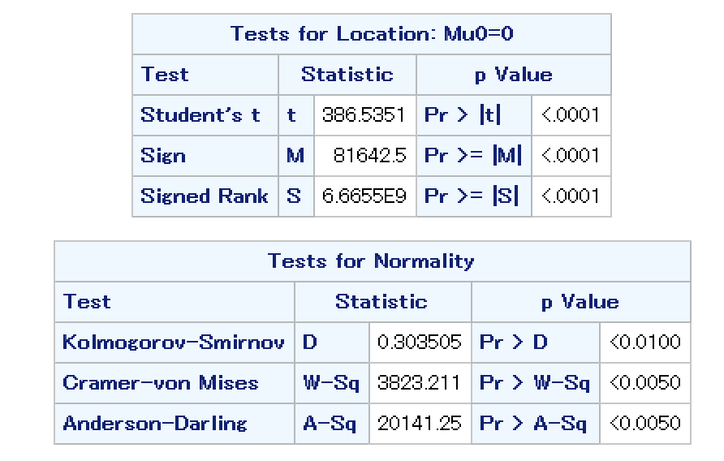
The distribution for average number of drinks per 30 days does not follow a normal curve. This data is skewed left.
Notes:
One continuous variable. Includes histogram and boxplot, numerical measures of location and variation

Slide 7
Categorical Variable: Physical Activity
How many times does the average person workout in 30 days?
/*Descriptive statistics for one categorical variable*/
data physicalactivity;
set project;
keep _TOTINDA;
where _TOTINDA~=9;
run;
proc FREQ data=physicalactivity;
title 'Desciptive Statistics for Physical Activity';
tables _TOTINDA;
run;
proc gchart data=physicalactivity;
title 'Physcial Activity';
vbar _TOTINDA / midpoints= 1 to 2 by 1;
run;
proc gchart data=physicalactivity;
pie _TOTINDA / discrete
value=inside percent=inside slice=outside;
run;

Slide 8
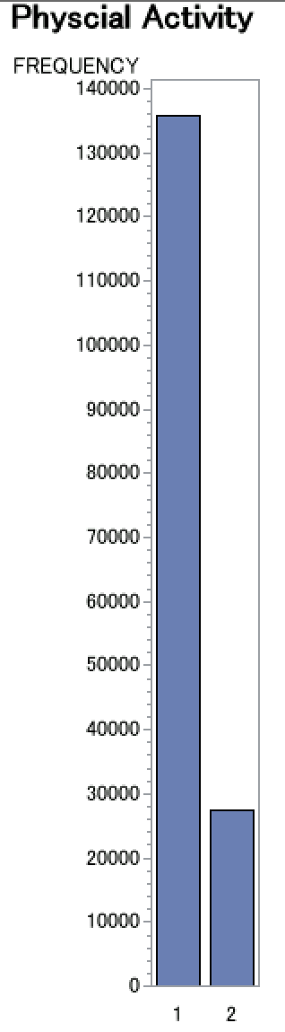
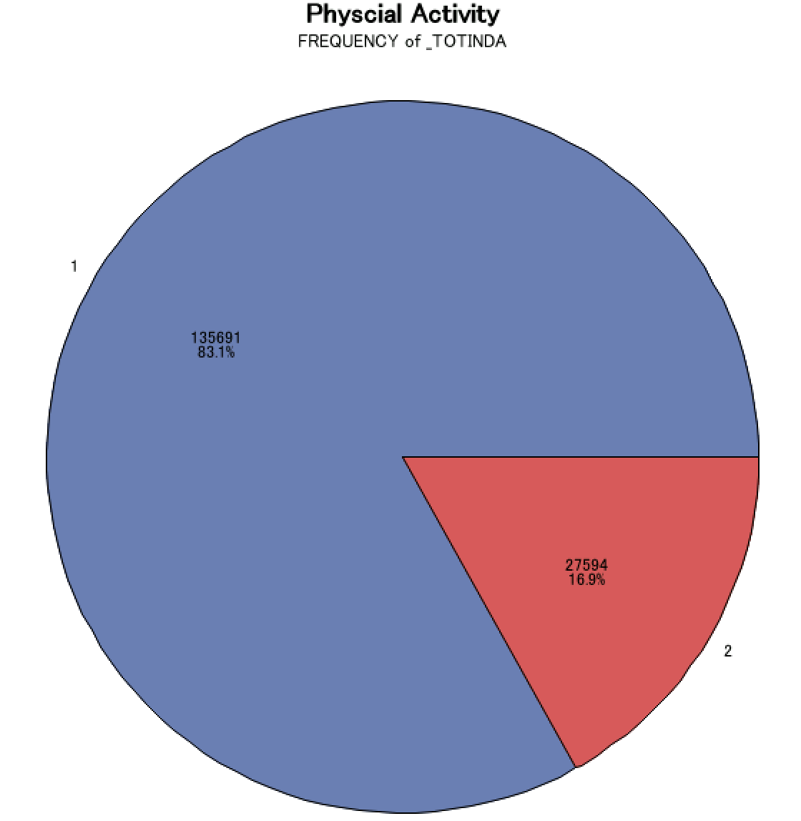
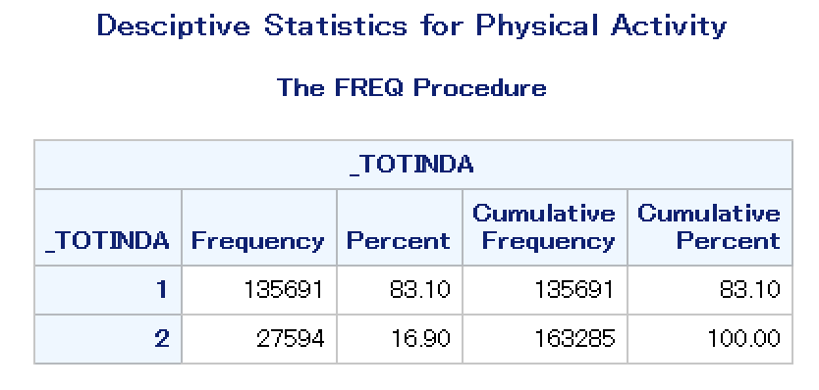
Categorical Variable: Physical Activity
How many times does the average person have in 30 days?
83.1% of patients report “yes” to physical activity outside of their regular job.
Notes:
one categorical variable. Includes pie graph/bar chart, frequencies and percentages.
1-HAD PHYSICAL ACTIVITY OR EXERCISE IN PAST 30 DAYS
2- NO PHY

Slide 9
Continuous Variable grouped by Categorical: BMI grouped by smoking
Are smoking status and BMI directly correlated?
data BMIbySmoking;
set project;
keep _BMI5 _SMOKER3;
where _SMOKER3 ~=9;
run;
proc means data=BMIbySmoking;
title 'Descriptive Statistics for BMI by Smoking Status';
class _SMOKER3;
var _BMI5;
run;
proc gchart data=BMIbySmoking;
title 'BMI by Smoking Status';
vbar _SMOKER3 / midpoints= 1 to 4 by 1 type=mean;
run;
_SMOKER3=1: Current everyday smoker
_SMOKER3=2: Current smoker sometimes
_SMOKER3=3: Former smoker
_SMOKER3=4: Never smoked
Notes:
BMI- 1-9999 INCLUDES 2 DECIMAL POINTS

Slide 10
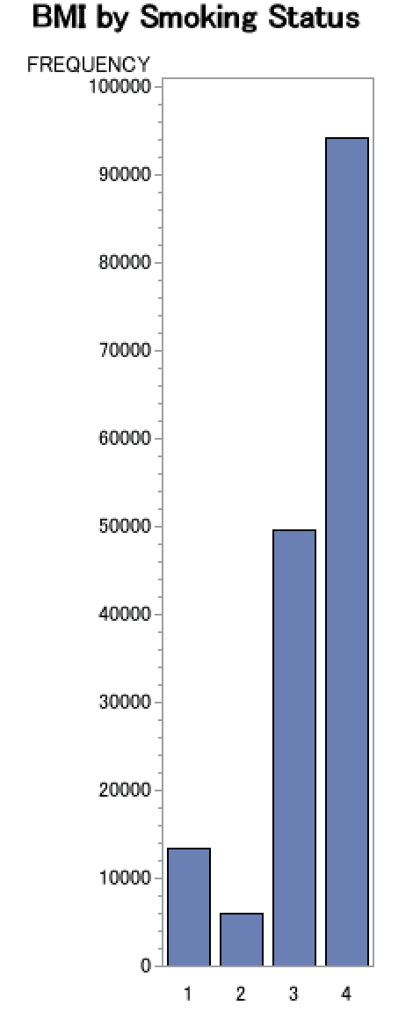
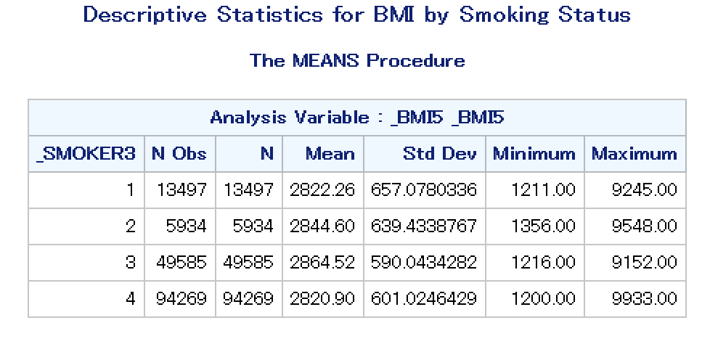
Average BMI is higher for patients who never smoked.
Notes:
one continuous variable grouped by a categorical variable

Slide 11
Test of normality, including measures of skewness,
comparing the mean to the median, histogram with normal
curve overlaid, normal q-q plot, and significance test for normality
/*Test of normality*/
data drinknormality;
set project;
where AVEDRNK3~=9 and AVEDRNK3 ne .;
run;
/*Histogram with normal curve overlay*/
ods select Histogram ParameterEstimates GoodnessofFit FitQuantiles Bins;
proc univariate data=drinknormality;
title 'Normality for Binge Drinking';
var AVEDRNK3;
histogram AVEDRNK3 / normal;
run;
/* QQ plot*/
proc univariate data=drinknormality;
title 'Normality for Average Drinks';
var AVEDRNK3;
qqplot AVEDRNK3 /normal (MU=EST SIGMA=EST COLOR=RED L=1);
run;
Notes:
Testing normality for average drinks. Average drinks is a continuous variable

Slide 12
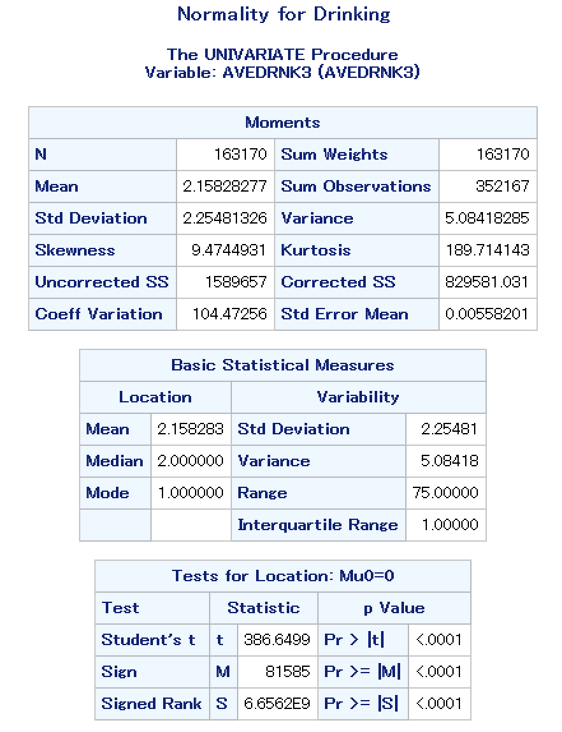
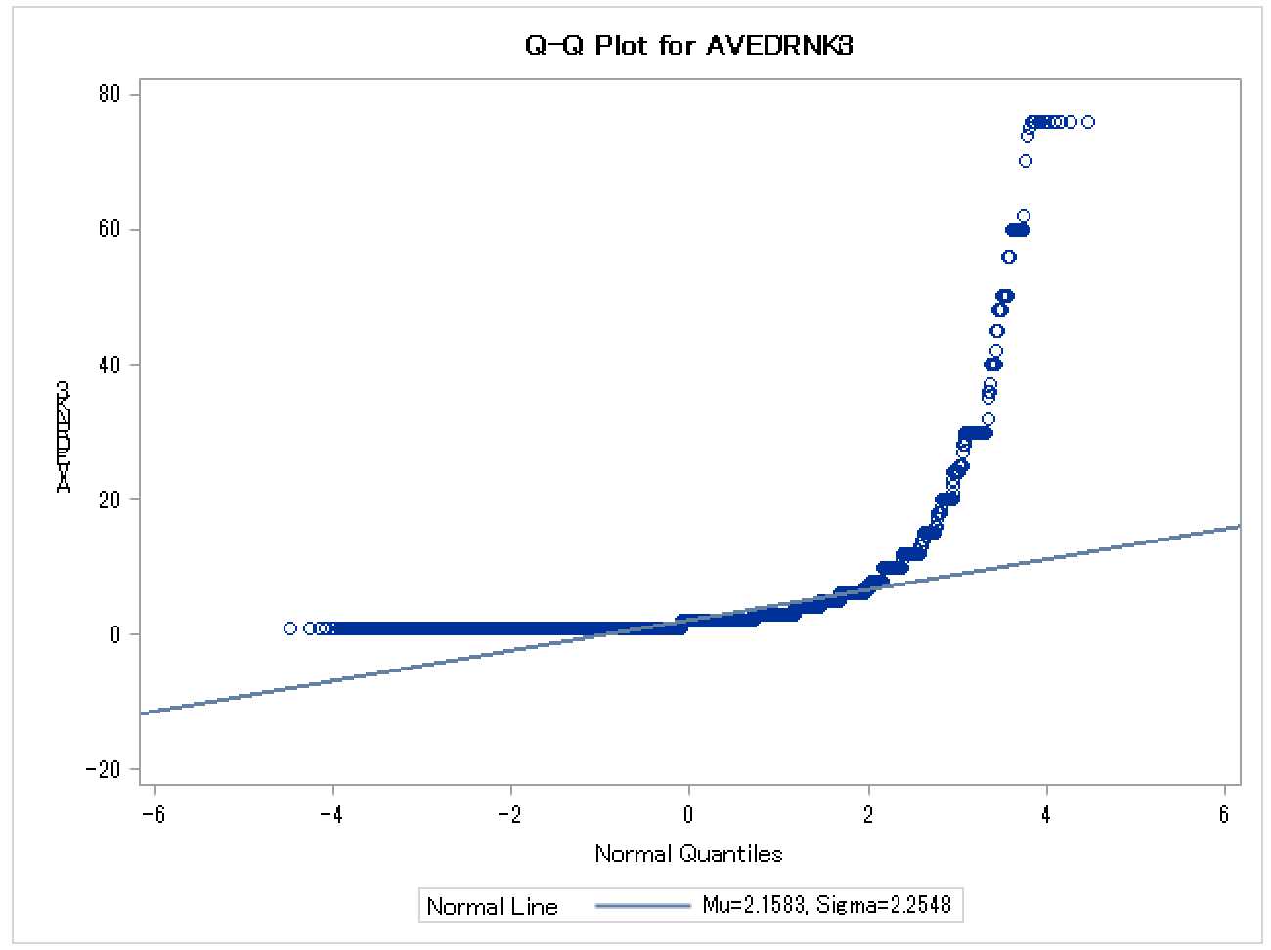
Notes:
Skewness is right or positive because the mean is higher than the median. Kurtosis is high. Therefore, it means it has heavy tails or outliers.
Our data for average drinks is not evenly distributed nor does it display a bell curve shape

Slide 13
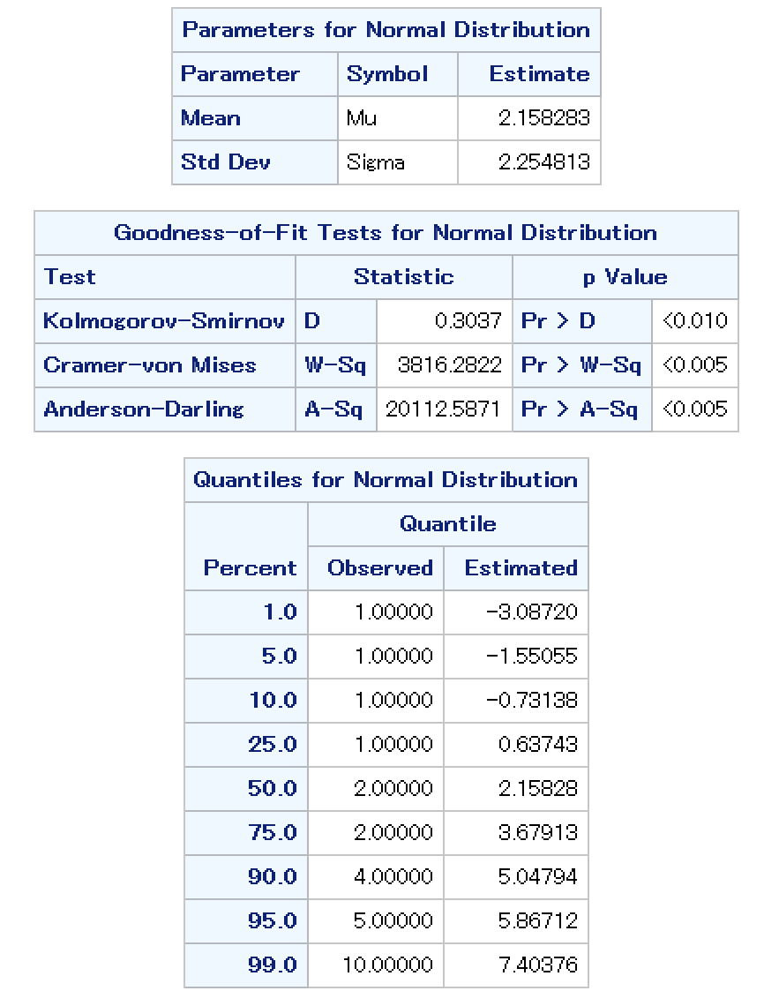
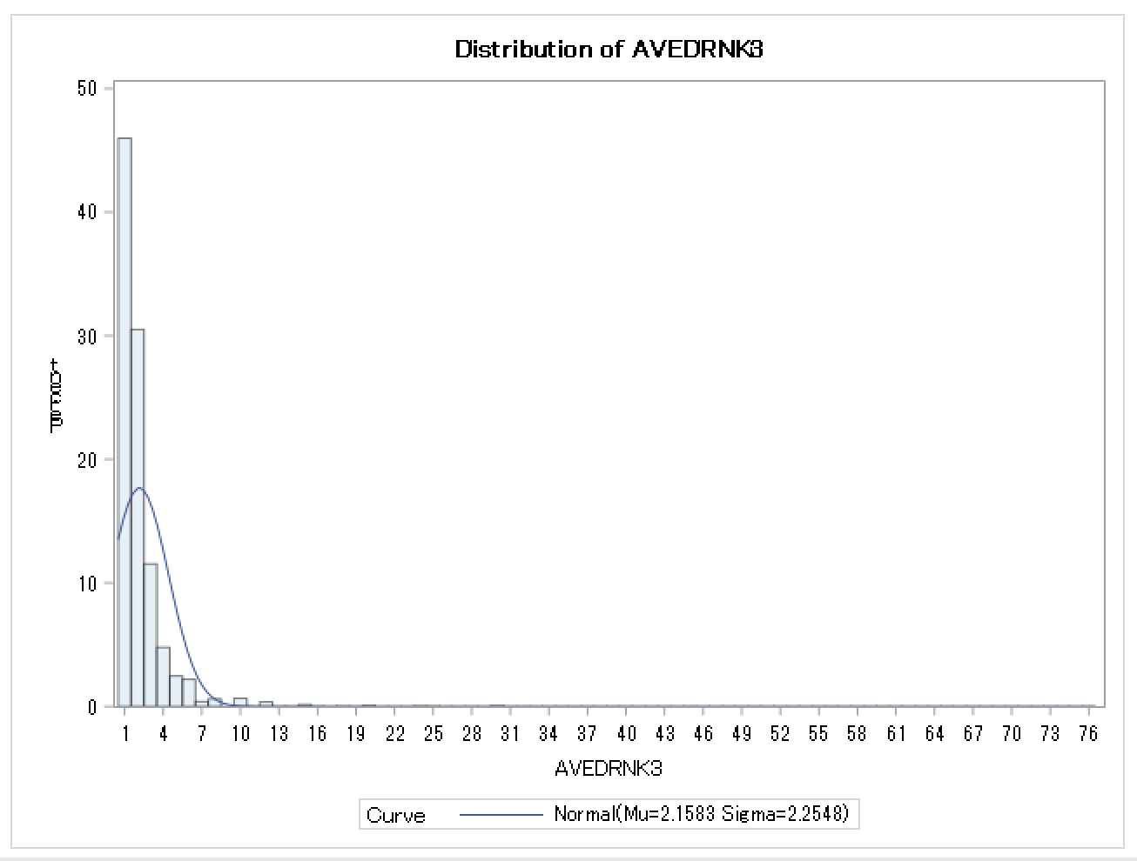
This data is not normal (P-Values for each goodness of fit test is <0.05, meaning it is significantly different, or not normal). However, it is a drinking variable so we expect some skew.

Slide 14
H1: There is a significantly higher risk of heart attack for people who have higher BMI of >25kg/m^2
H0: There is not significantly higher risk of heart attack for people who have higher BMI of >25kg/m^2.
Test for H0 with 95% confidence interval (CI)
data BMIheartattack;
set project;
keep CVDINFR4 _BMI5;
where CVDINFR4=1;
run;
proc ttest data=BMIheartattack h0=2500 sides=U alpha=0.05 plots= none;
title 'One Sided T-test';
var _BMI5;
run;
Notes:
If your BMI is between 25-30 it indicates overweight status or if your BMI is over 30 it indicates a obesity status

Slide 15
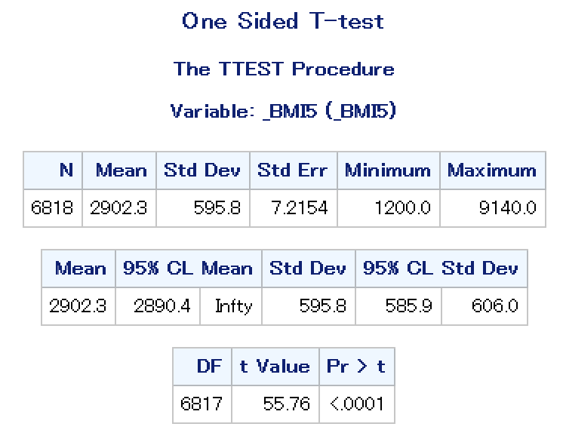
There is a statistically higher chance of a person with a BMI >25% having a heart attack compared to someone with BMI<25%.
However, the hypothesized value is not included in the 95% CI [29.19-infinity].
This means we can say with 95% confidence that someone who has had a heart attack will fall within the 28.9+ BMI range.
Notes:
Statistically significant because the P-value is less than 0.05.
A one-tailed test is appropriate if you only want to determine if there is a difference between groups in a specific direction.

Slide 16
Contingency table with Chi-square significance
test for H0: Does heart attack risk increase with age?
data ageMI;
set project;
keep _age_g CVDINFR4;
where CVDINFR4<7;
run;
proc freq data=ageMI;
TITLE 'Chi-Squared Test for Age Group and Heart Attack';
tables CVDINFR4* _AGE_G / chisq expected relrisk;
run;
Notes:
Chi-square with age, physical activity, etc. with a heart attack

Slide 17
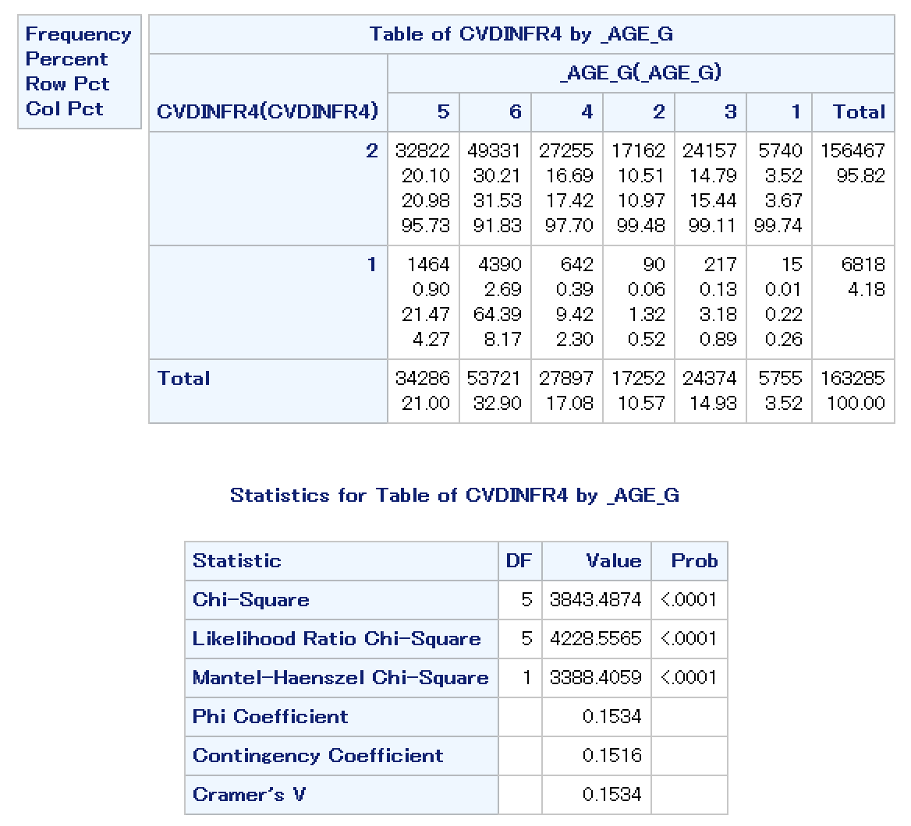
As expected, the chi- square test shows us that heart attack risk increases as age increases.

Slide 18
Independent t-test: Is there a significant difference between vegetable consumption and age?
data ageveg;
set project;
keep _VEGESU1 _AGE_G AGEGROUP;
where _VEGESU1<99998;
if 1<_AGE_G<3 then AGEGROUP= 1;
else AGEGROUP= 2;
run;
proc ttest data=ageveg;
title 'Independent T test for Vegetable Consumption and Age';
class AGEGROUP;
var _VEGESU1;
run;

Slide 19
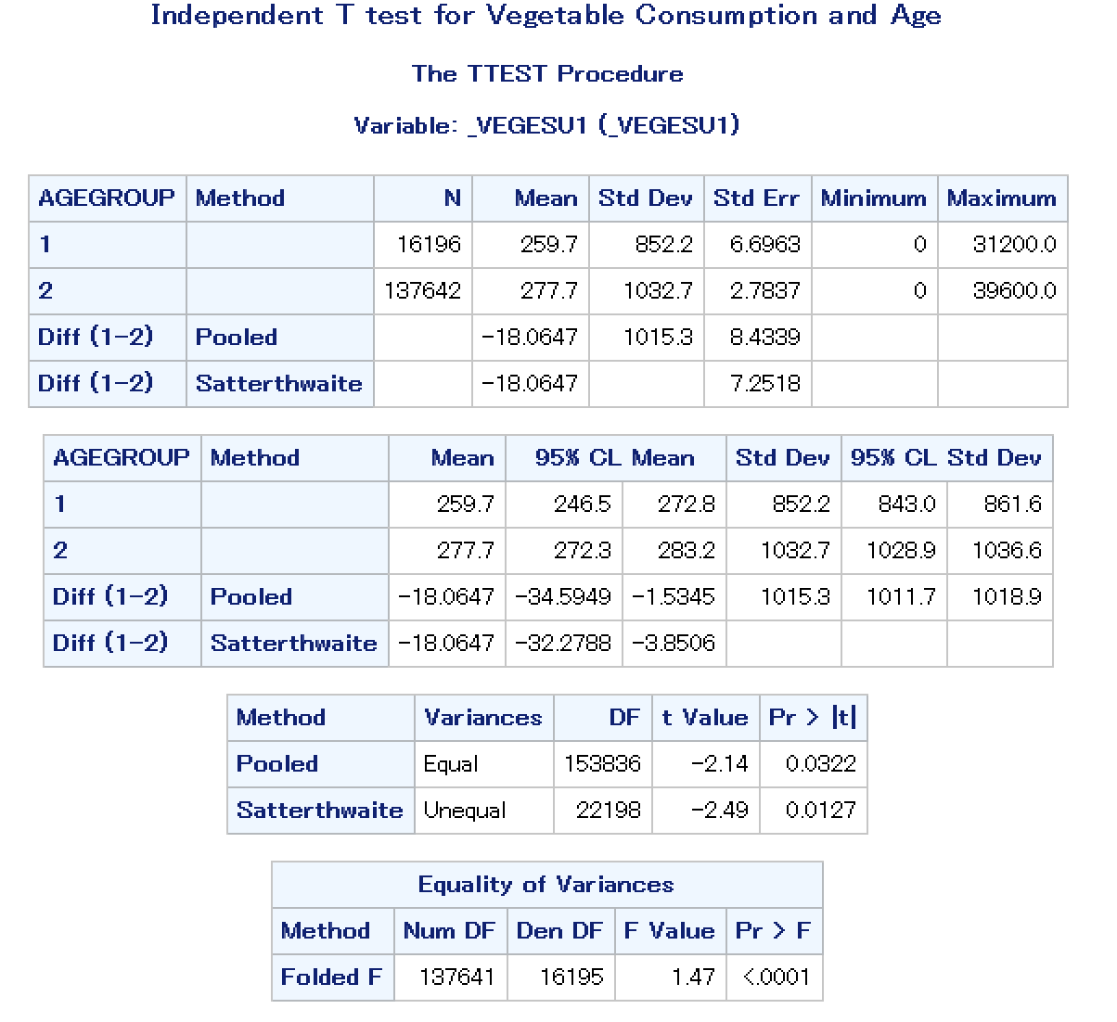
There is a statistically significant increase in vegetable consumption in patients age 45+.

Slide 20
Linear Correlation:
Is vegetable consumption correlated with BMI?
data BMIbyVegetables;
set project;
run;
proc sgplot data=BMIbyVegetables (firstobs=1 obs=500);
title 'BMI by Vegetable Consumption';
scatter x=_BMI5 y=_VEGESU1;
Ellipse x=_BMI5 y=_VEGESU1;
run;
proc corr data=BMIbyVegetables;
title 'Linear Correlation for BMI and Vegetable Consumption';
var _BMI5 _VEGESU1;
run;

Slide 21
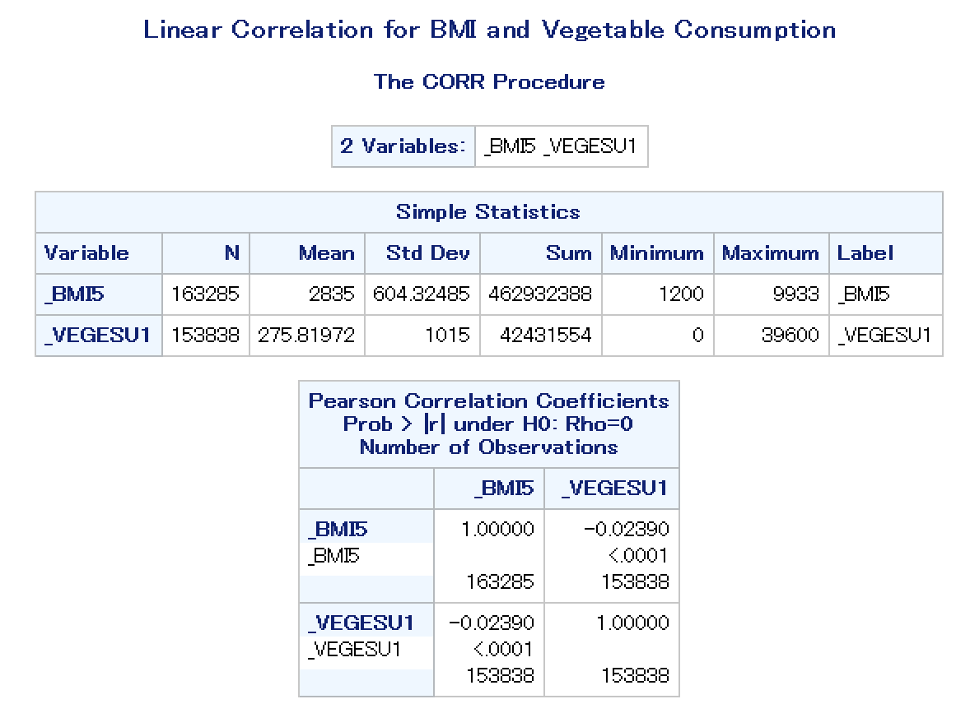
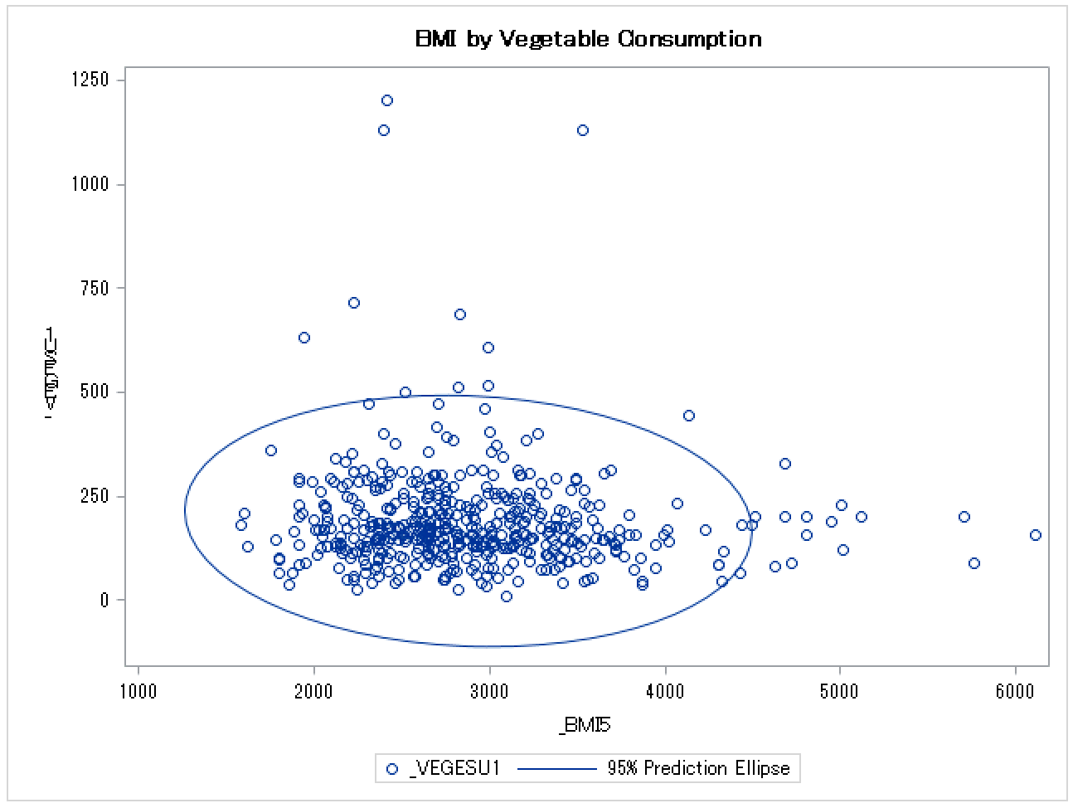
Mean BMI is 28.35 and mean vegetables consumed in a day is 2.78. These values have a loose, negative (but still statistically significant) correlation. This means that as BMI increases, vegetable consumption decreases.

Slide 22
Simple Logistic Regression Analysis:
data simplogistic;
set project;
KEEP _VEGESU1 CVDINFR4;
RUN;
PROC LOGISTIC DATA=simplogistic;
title 'Logistic Regression- Vegetable Consumption and Heart Attack';
MODEL CVDINFR4 (EVENT='1')=_VEGESU1;
WHERE _VEGESU1<99998 AND CVDINFR4<7 AND CVDINFR4~=.;
RUN;

Slide 23
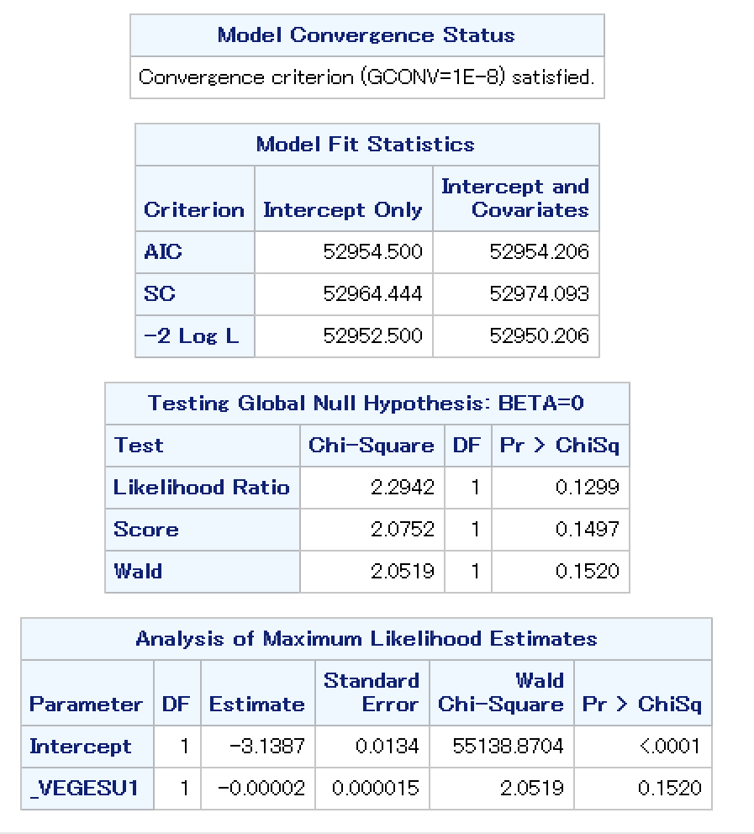
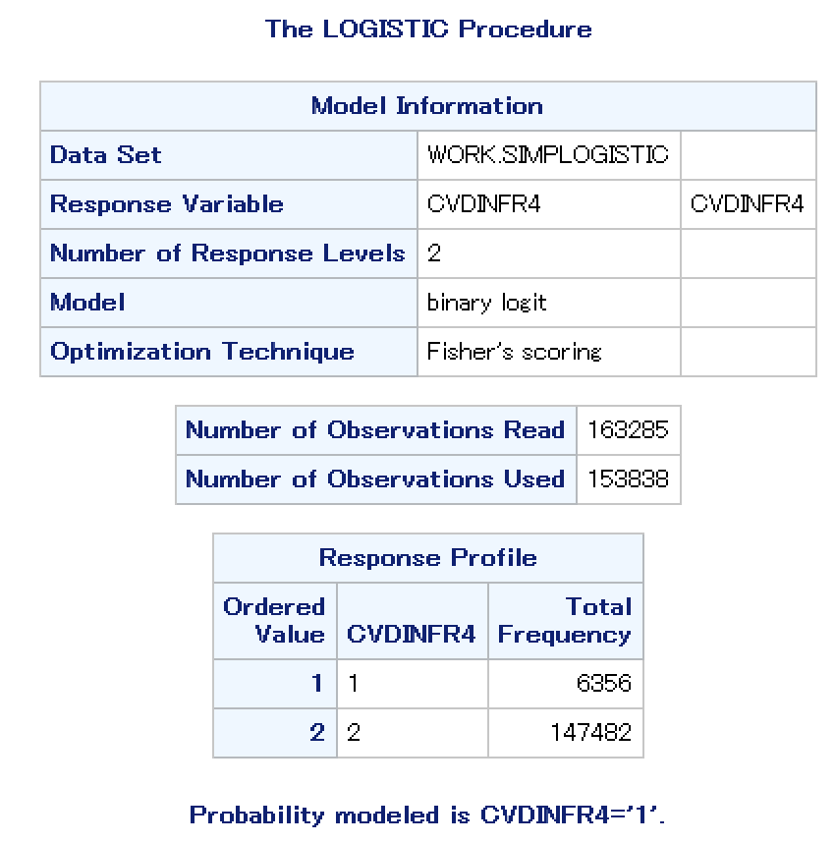
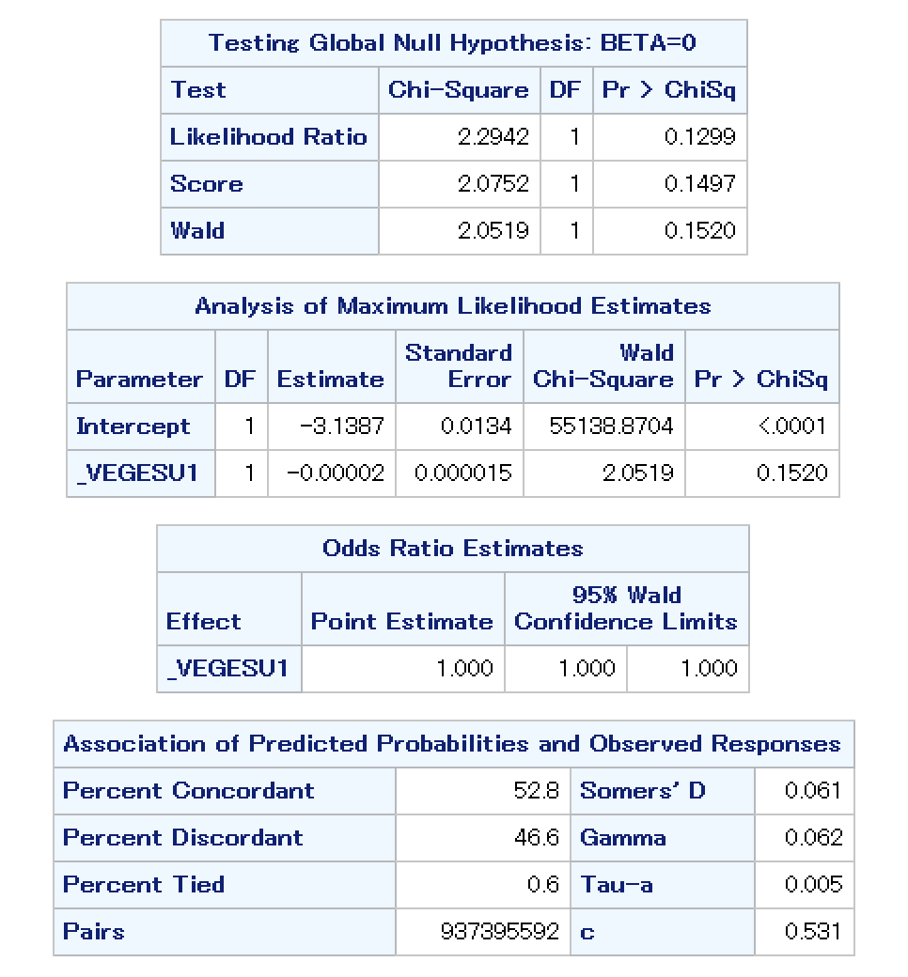
Vegetable consumption is not a statistically significant contributor to heart attack in regard to the BRFSS survey results.

Slide 24
H0: There is no increased risk of heart attack among people with hypertension and high cholesterol
H1: There is increased risk of heart attack among people with hypertension and high cholesterol.
Multiple Logistic Regression Hypothesis:

Slide 25
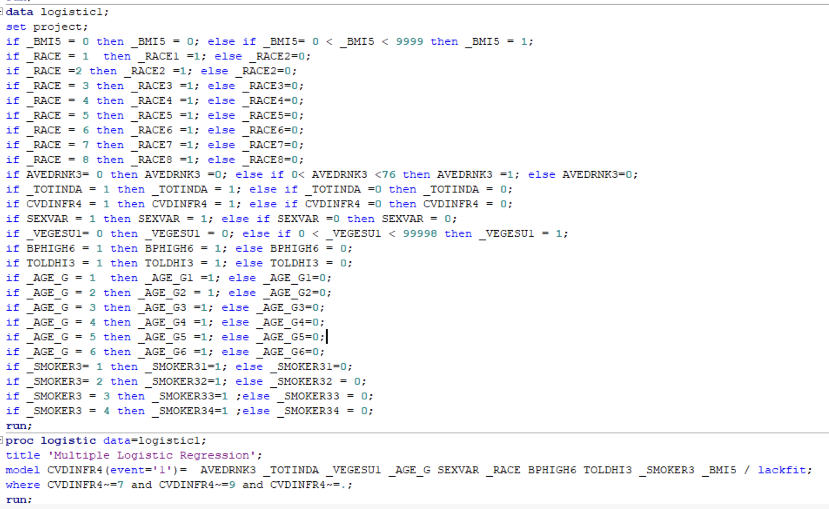
Multiple Logistic Regression

Slide 26
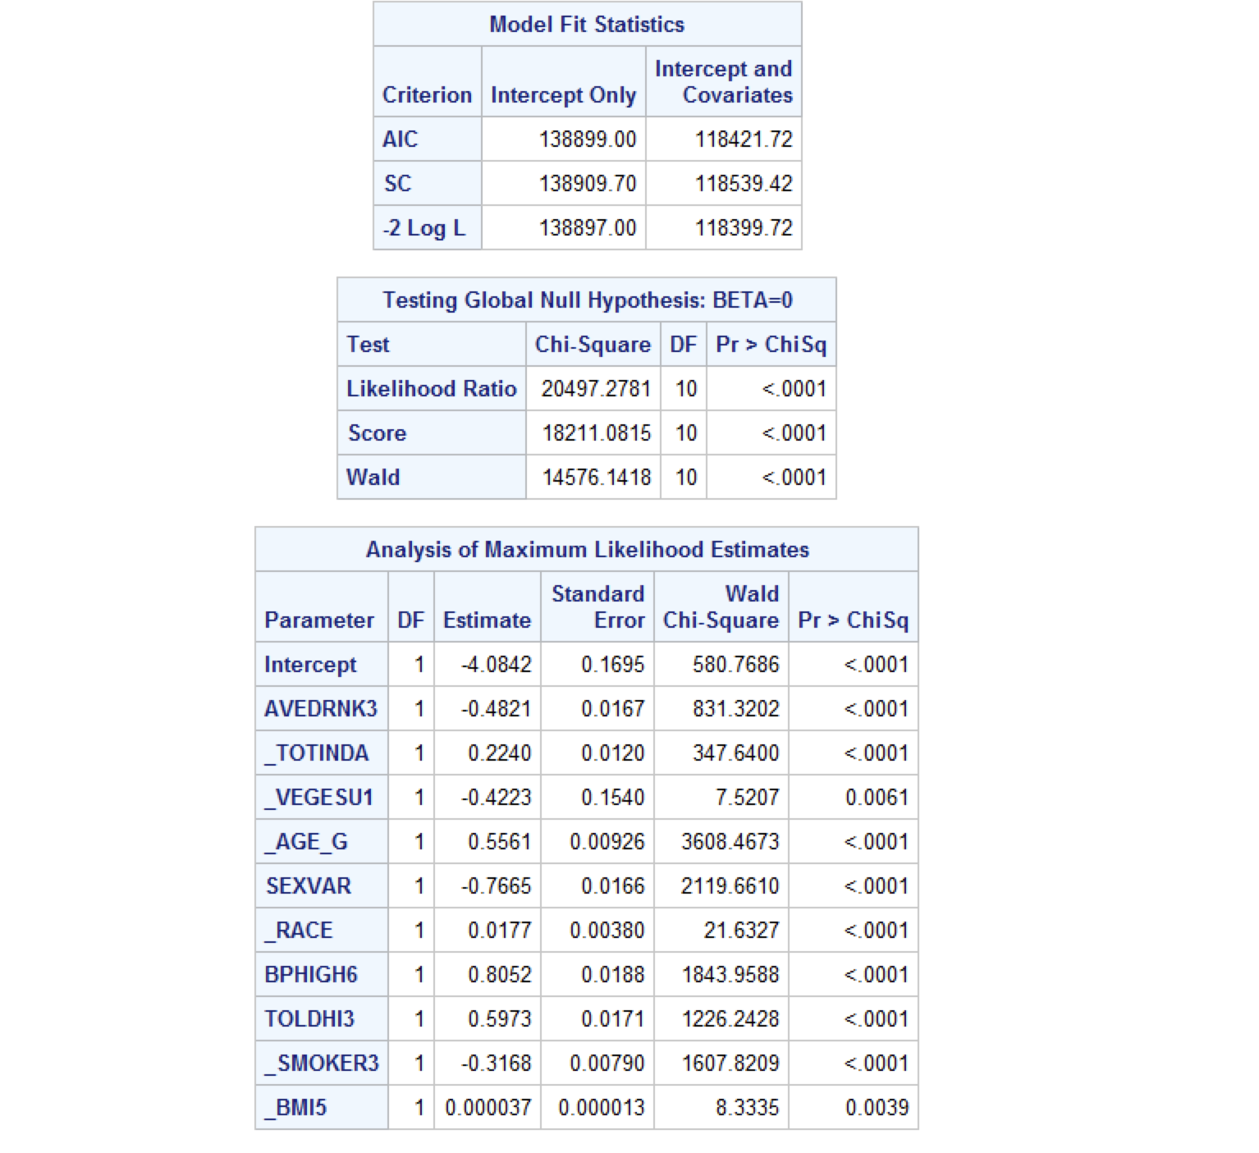
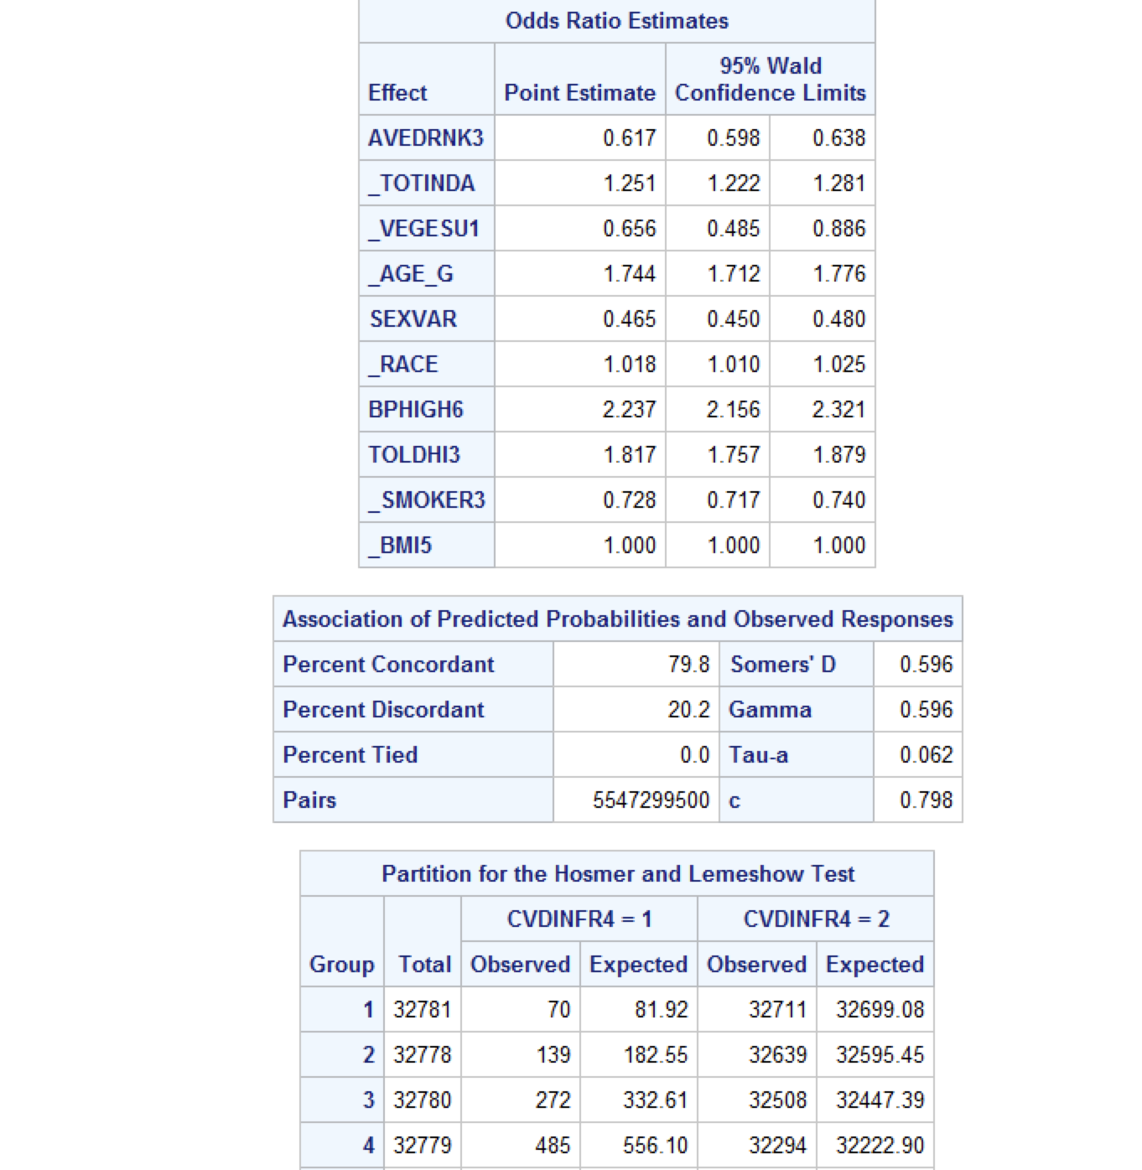

Slide 27
Results of Logistic Regression
The odds of heart attack among people who have hypertension and high serum cholesterol is 0.8062 and 0.5973 times respectively than those without hypertension and high serum cholesterol adjusting for possible confounders.
The p-value is less than 0.05 which means we reject the null hypothesis and conclude that there is increased risk of heart attack among people with hypertension and high cholesterol.

Slide 28
Conclusion and Discussion:
Conclusions:
Heart attack is associated with a wide range of behavioral risk factors and determinants of health.
Surveillance data does not trend with the majority of the population
Dependent on controlled sample sizes
Study limitations:
Survey bias
Binary variables limited the analysis. If we had more robust data, more concrete conclusions
could be made
Identify items you found most:
Enjoyable/interesting: working together
Challenging: handling missing data, null values, compartmentalized

Slide 29
Appendices:
Appendix 1: https://www.cdc.gov/brfss/annual_data/annual_2021.html 2021 BRFSS Data (SAS Transport Format)
[ZIP – 64.3 MB]
Appendix 2:
Isabella: built foundation and created slidedeck, collaborated in writing code, presented introduction and conclusion
Sydney: led and drove the group in writing the code and interpretations, presented visual analytics and findings
Jason: collaborated in writing code, expanded on slides, presented visual analytics and findings
Anjala: researched and selected the dataset, collaborated in writing code, presented visual analytics and findings
Sireesha: collaborated in writing code, expanded on interpretations, presented visual analytics and findings
Appendix 3:
Multiple logistic regression analysis was not covered in the oral presentation
Cholesterol and hypertension variables were not presented in the oral presentation

Slide 30
References:
Centers for Disease Control and Prevention. (2022, October 14). Heart disease facts. Centers for Disease Control and Prevention. Retrieved December 8, 2022, from https://www.cdc.gov/heartdisease/facts.html
Ding, C., O'Neill, D., Bell, S., Stamatakis, E., & Britton, A. (2021, July 27). Association of alcohol consumption with morbidity and mortality in patients with cardiovascular disease: Original Data and meta-analysis of 48,423 men and women - BMC medicine. Retrieved November 28, 2022, from https://bmcmedicine.biomedcentral.com/articles/10.1186/s12916-021-02040-2
Heart disease risk: How race and ethnicity play a role. Cleveland Clinic. (2022, May). Retrieved November 28, 2022,
from https://my.clevelandclinic.org/health/articles/23051-ethnicity-and-heart-disease
Myers, J. (2003, January 7). Exercise and cardiovascular health. Circulation. Retrieved November 28, 2022, from https://www.ahajournals.org/doi/full/10.1161/01.CIR.0000048890.59383.8D

